Slide 1







Concolic Program Repair
Detecting and discarding over-fitting patches via systematic co-exploration of the patch space and input space
Ridwan Shariffdeen
Yannic Noller
Lars Grunske
Abhik Roychoudhury

Slide 2



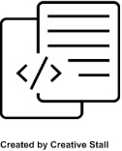
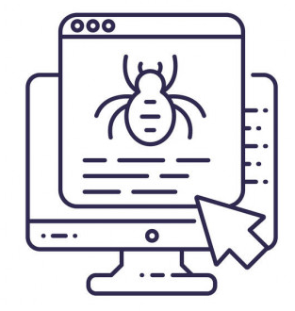

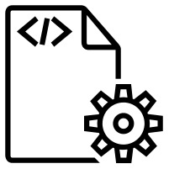
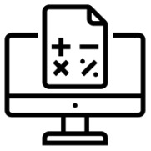
Program Repair
analyzed data
fault location
bug report
debugging
write patch
analyze
repaired
program
test suite
test
results
verification

Slide 3
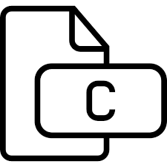
Automated Program Repair
test suite
bug report
debug
generate
validate
Automated Program Repair
analyze
list of patches

Slide 4

Automated Program Repair
Current APR generates:
Too many patches
Non-sensical patches
Over-fitting patches

Slide 5
Automated Program Repair
Examples of non-sensical patches:
if (((1 > 0) && (1 > 0)))
if (((! (image->res_unit == 3)) && (! (image->res_unit == 3))))
if( (! (((! ((- 4) == 0))) && ((! (0 == 0)) || (! (64 == 0))))))
if( (! ((log_level && (! ((- 4) == 0))) && log_level)))

Slide 6


Automated Program Repair
Can we generate patches:
Less in quantity
High in quality

Slide 7
Key Idea
Detecting and discarding over-fitting patches via systematic co-exploration of the patch space and input space

Slide 8
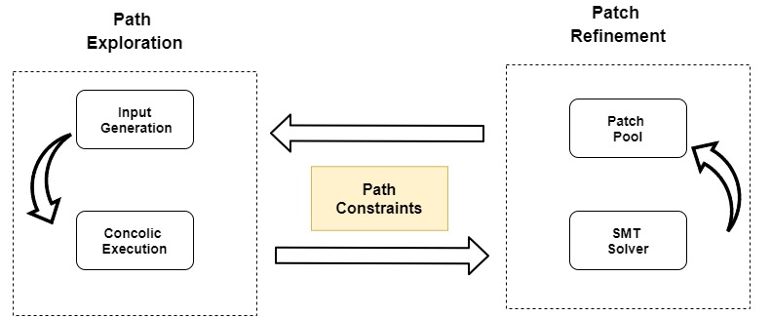
Co-Exploration

Slide 9
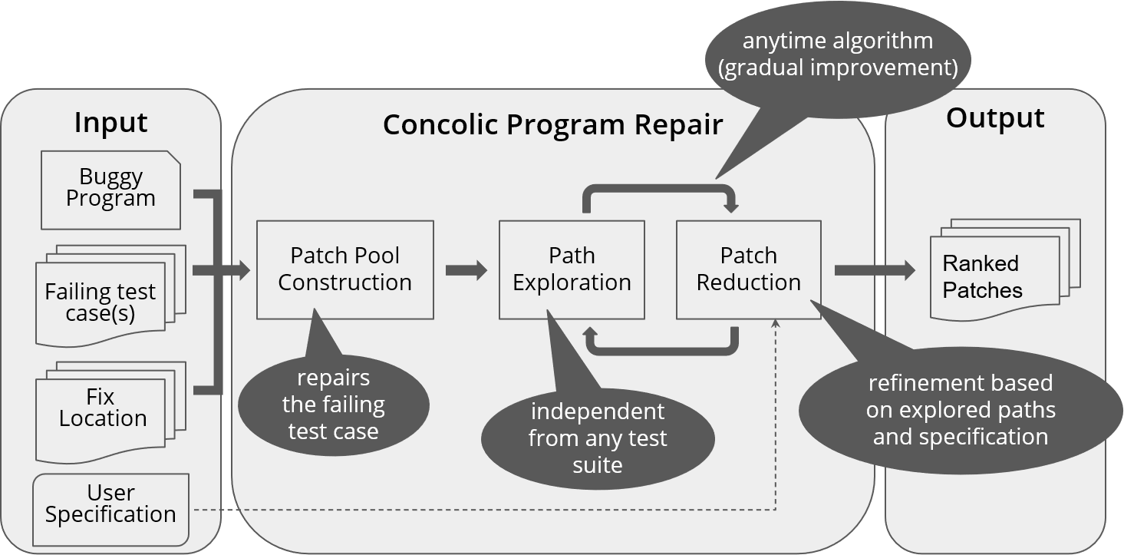


CPR Tool
rshariffdeen/cpr

Slide 10
Evaluation
Techniques
CEGIS
Benchmarks
ExtractFix
Results
Up to 74% Patch Space Reduction
ExtractFix
Angelix
Prophet
ManyBugs
SV-COMP

Slide 11
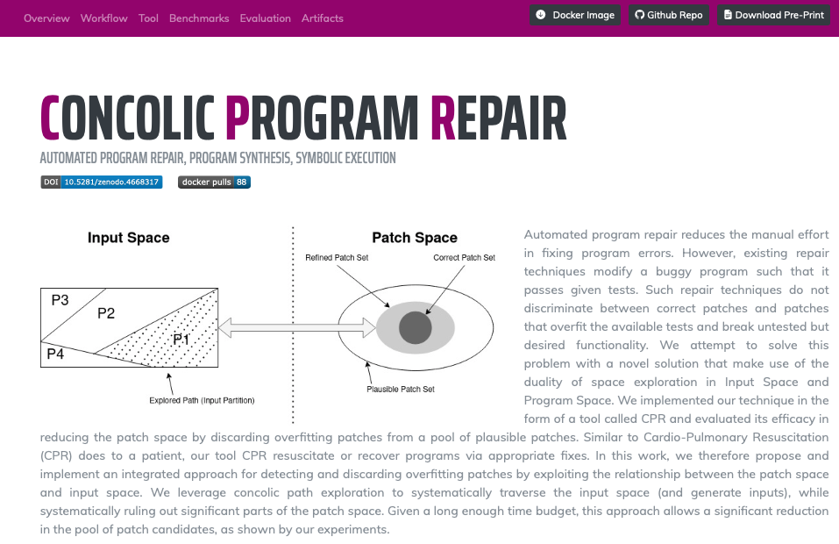

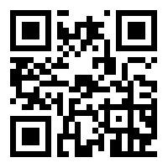


Artifact
https://cpr-tool.github.io
http://doi.org/10.5281/zenodo.4668317

